Slide 1
Artificial Intelligence Introduction to Prolog
SWI Prolog interpreter http://www.swi-prolog.org/

Slide 2
SWI Prolog
Freely available Prolog interpreter
Works with
Linux,
Windows, or
Mac OS
There are many more Prolog interpreters
Not all are ISO compliant

Slide 3
Lecture 1
Theory
Introduction to Prolog
Facts, Rules and Queries
Prolog Syntax

Slide 4
Aim of this lecture
Give some simple examples of Prolog programs
Discuss the three basic constructs in Prolog:
Facts
Rules
Queries
Introduce other concepts, such as
the role of logic
unification with the help of variables
Begin the systematic study of Prolog by defining terms, atoms, and variables

Slide 5
Prolog
"Programming with Logic"
Declarative
Very different from other (procedural) programming languages
Good for knowledge-rich tasks

Slide 6
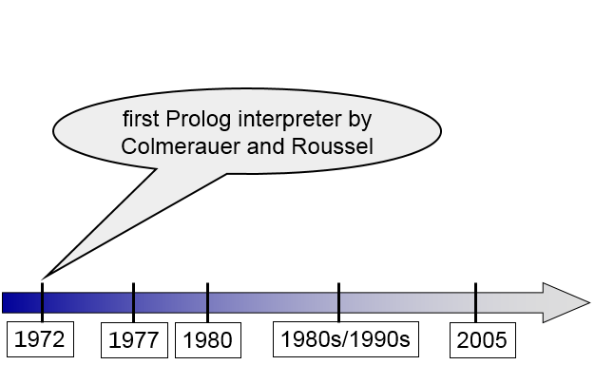
History of Prolog

Slide 7
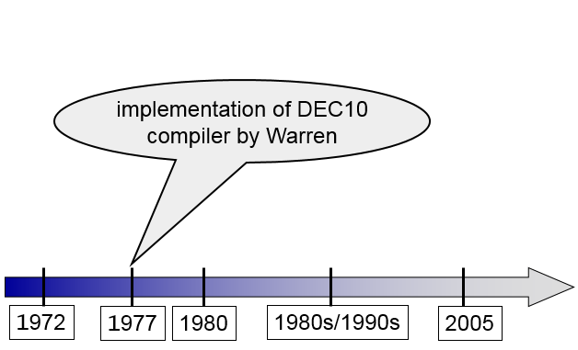
History of Prolog

Slide 8
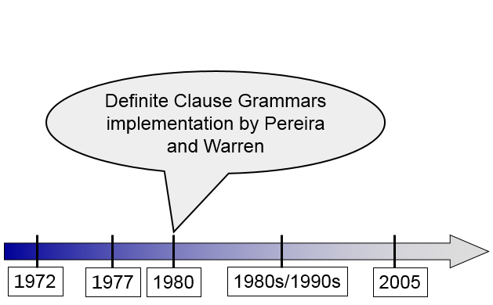
History of Prolog

Slide 9
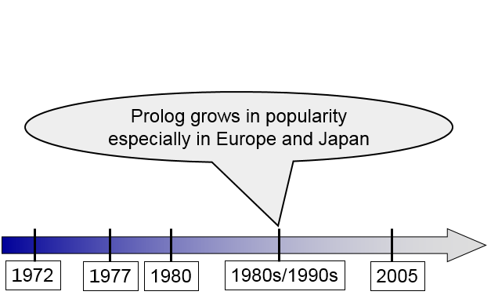
History of Prolog

Slide 10
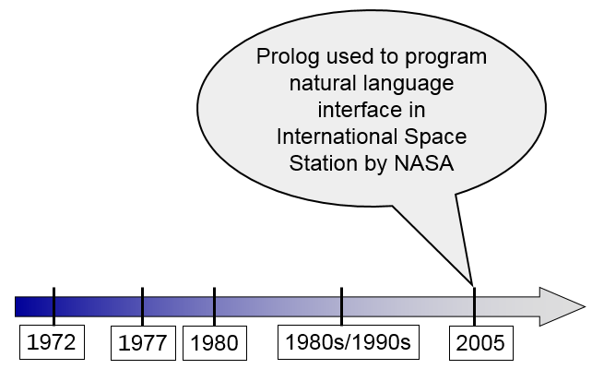
History of Prolog

Slide 11
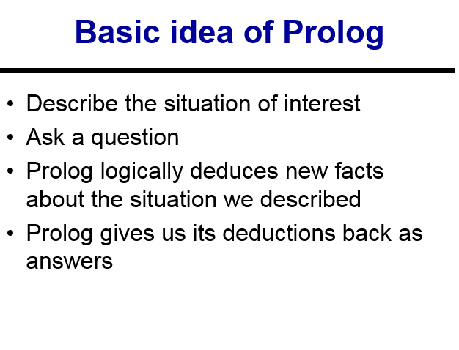

Slide 12
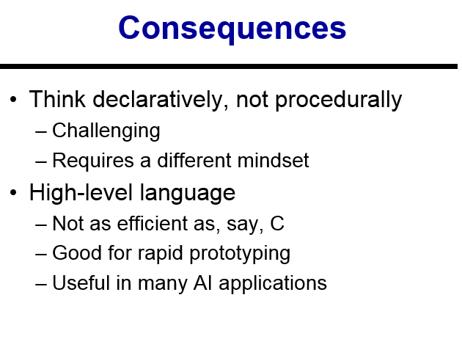

Slide 13
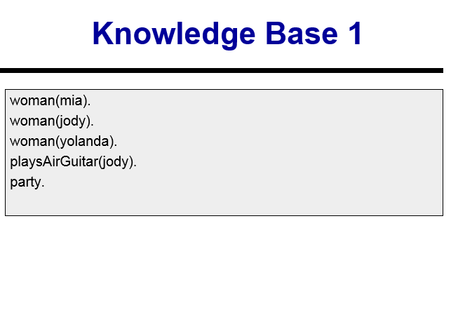

Slide 14
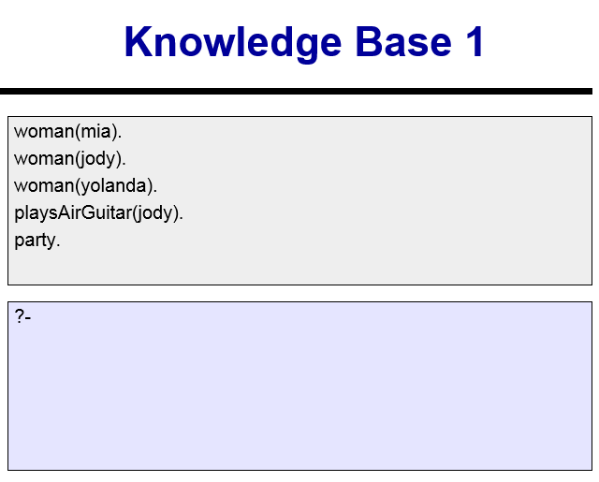

Slide 15
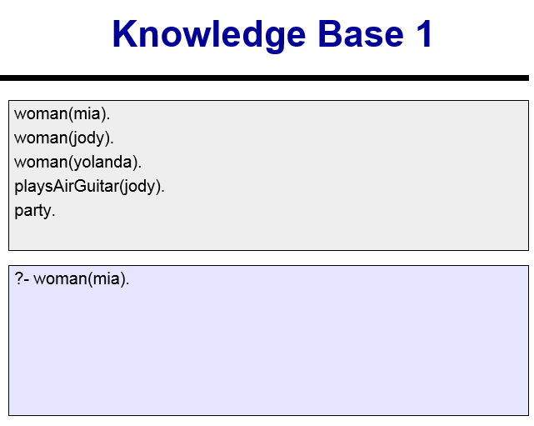

Slide 16
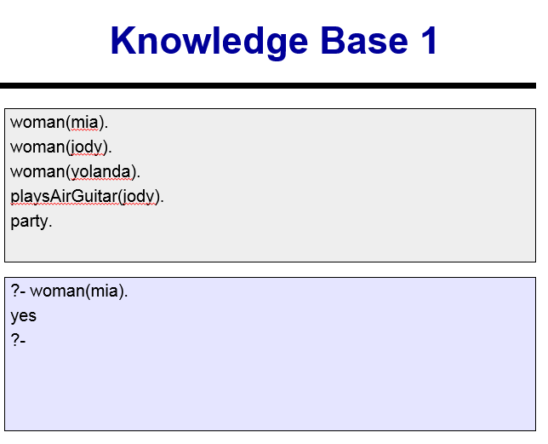

Slide 17
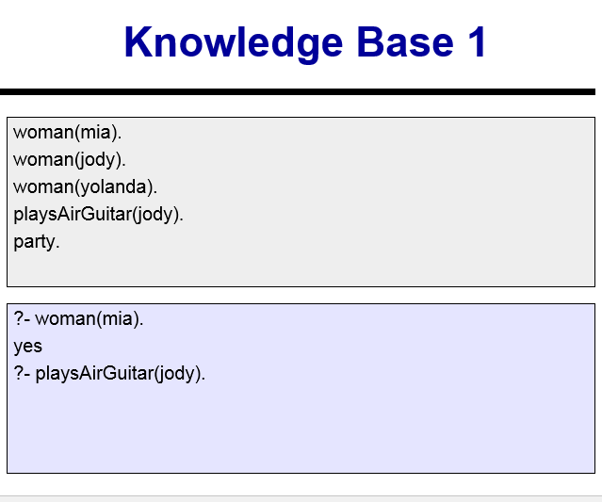

Slide 18
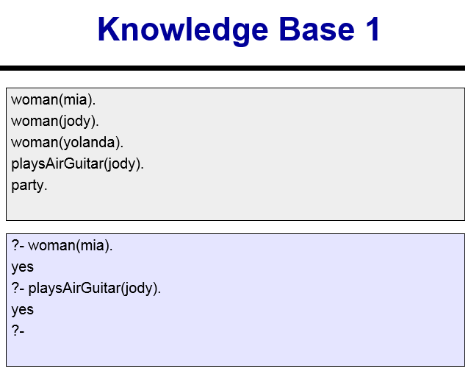

Slide 19
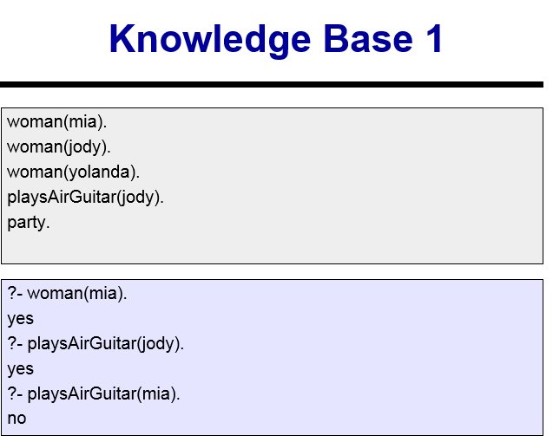

Slide 20
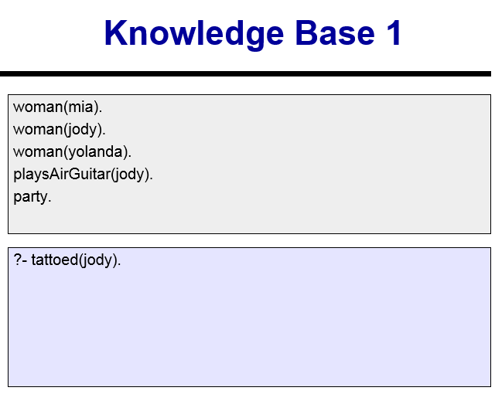

Slide 21
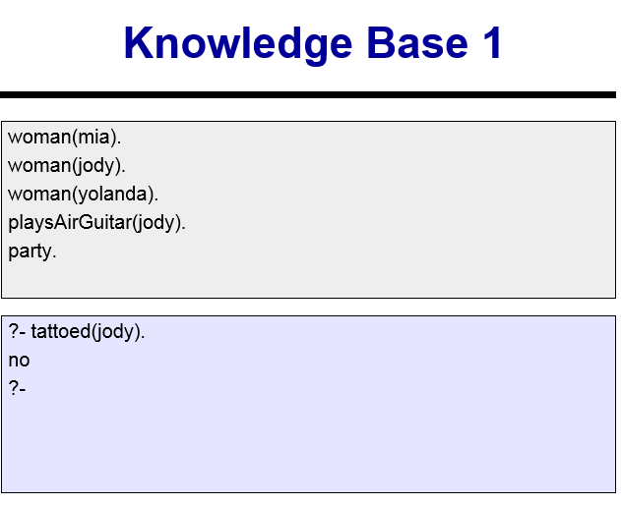

Slide 22
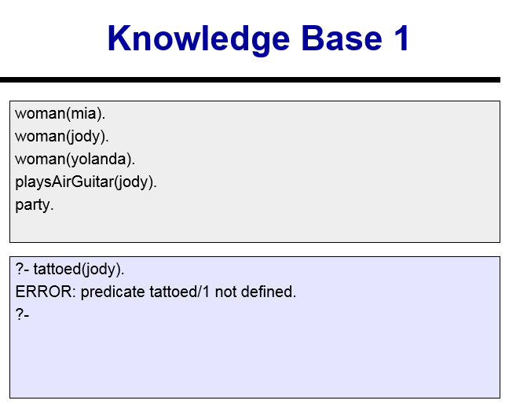

Slide 23
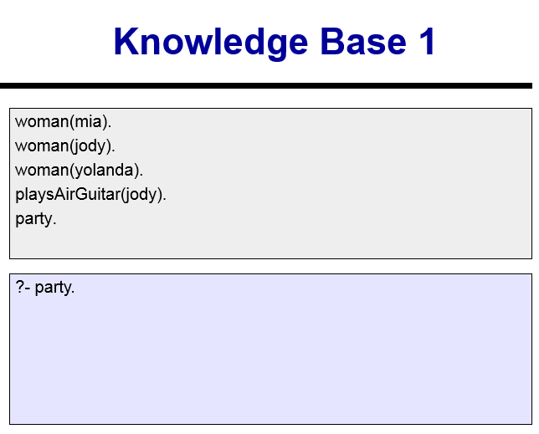

Slide 24
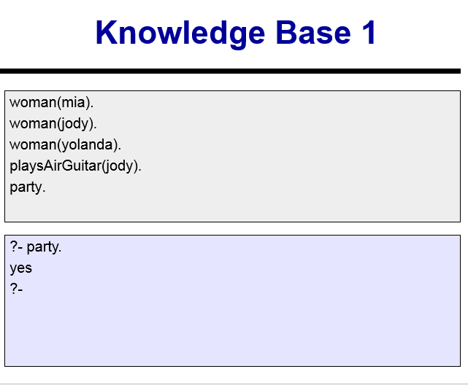

Slide 25
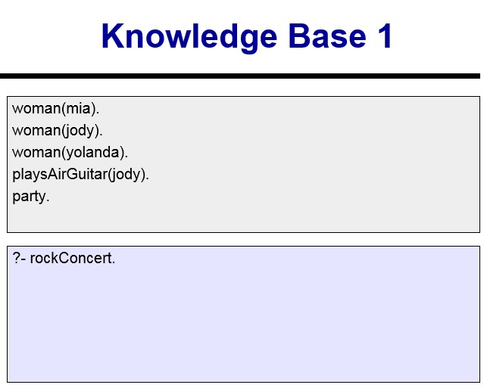

Slide 26
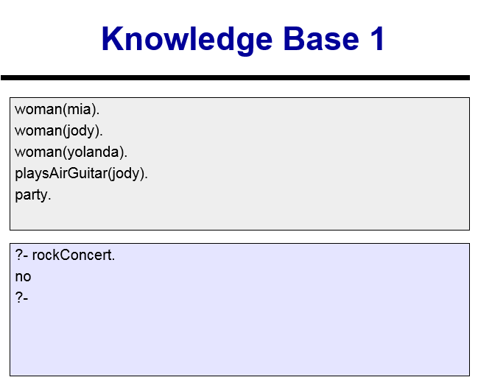

Slide 27
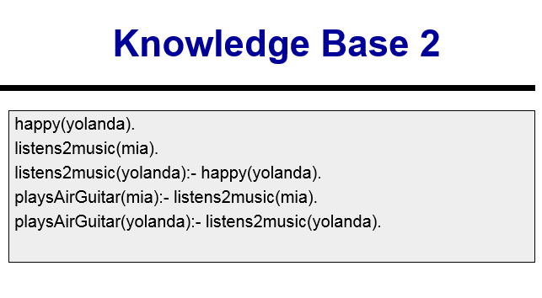

Slide 28
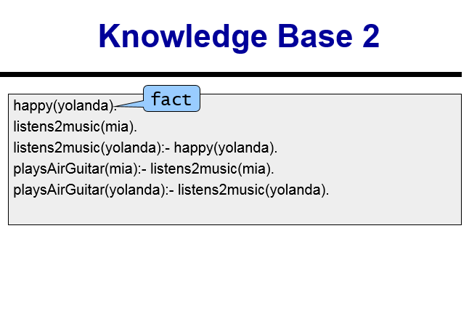

Slide 29
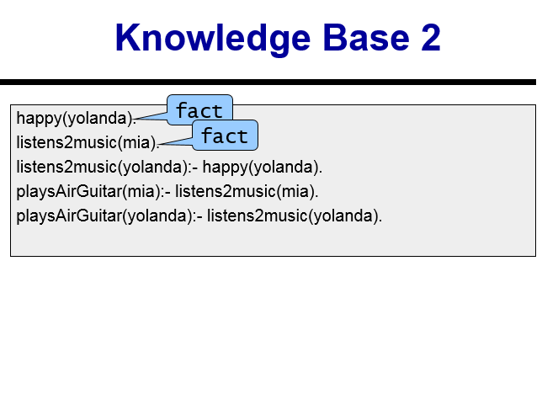

Slide 30
